Slide 1
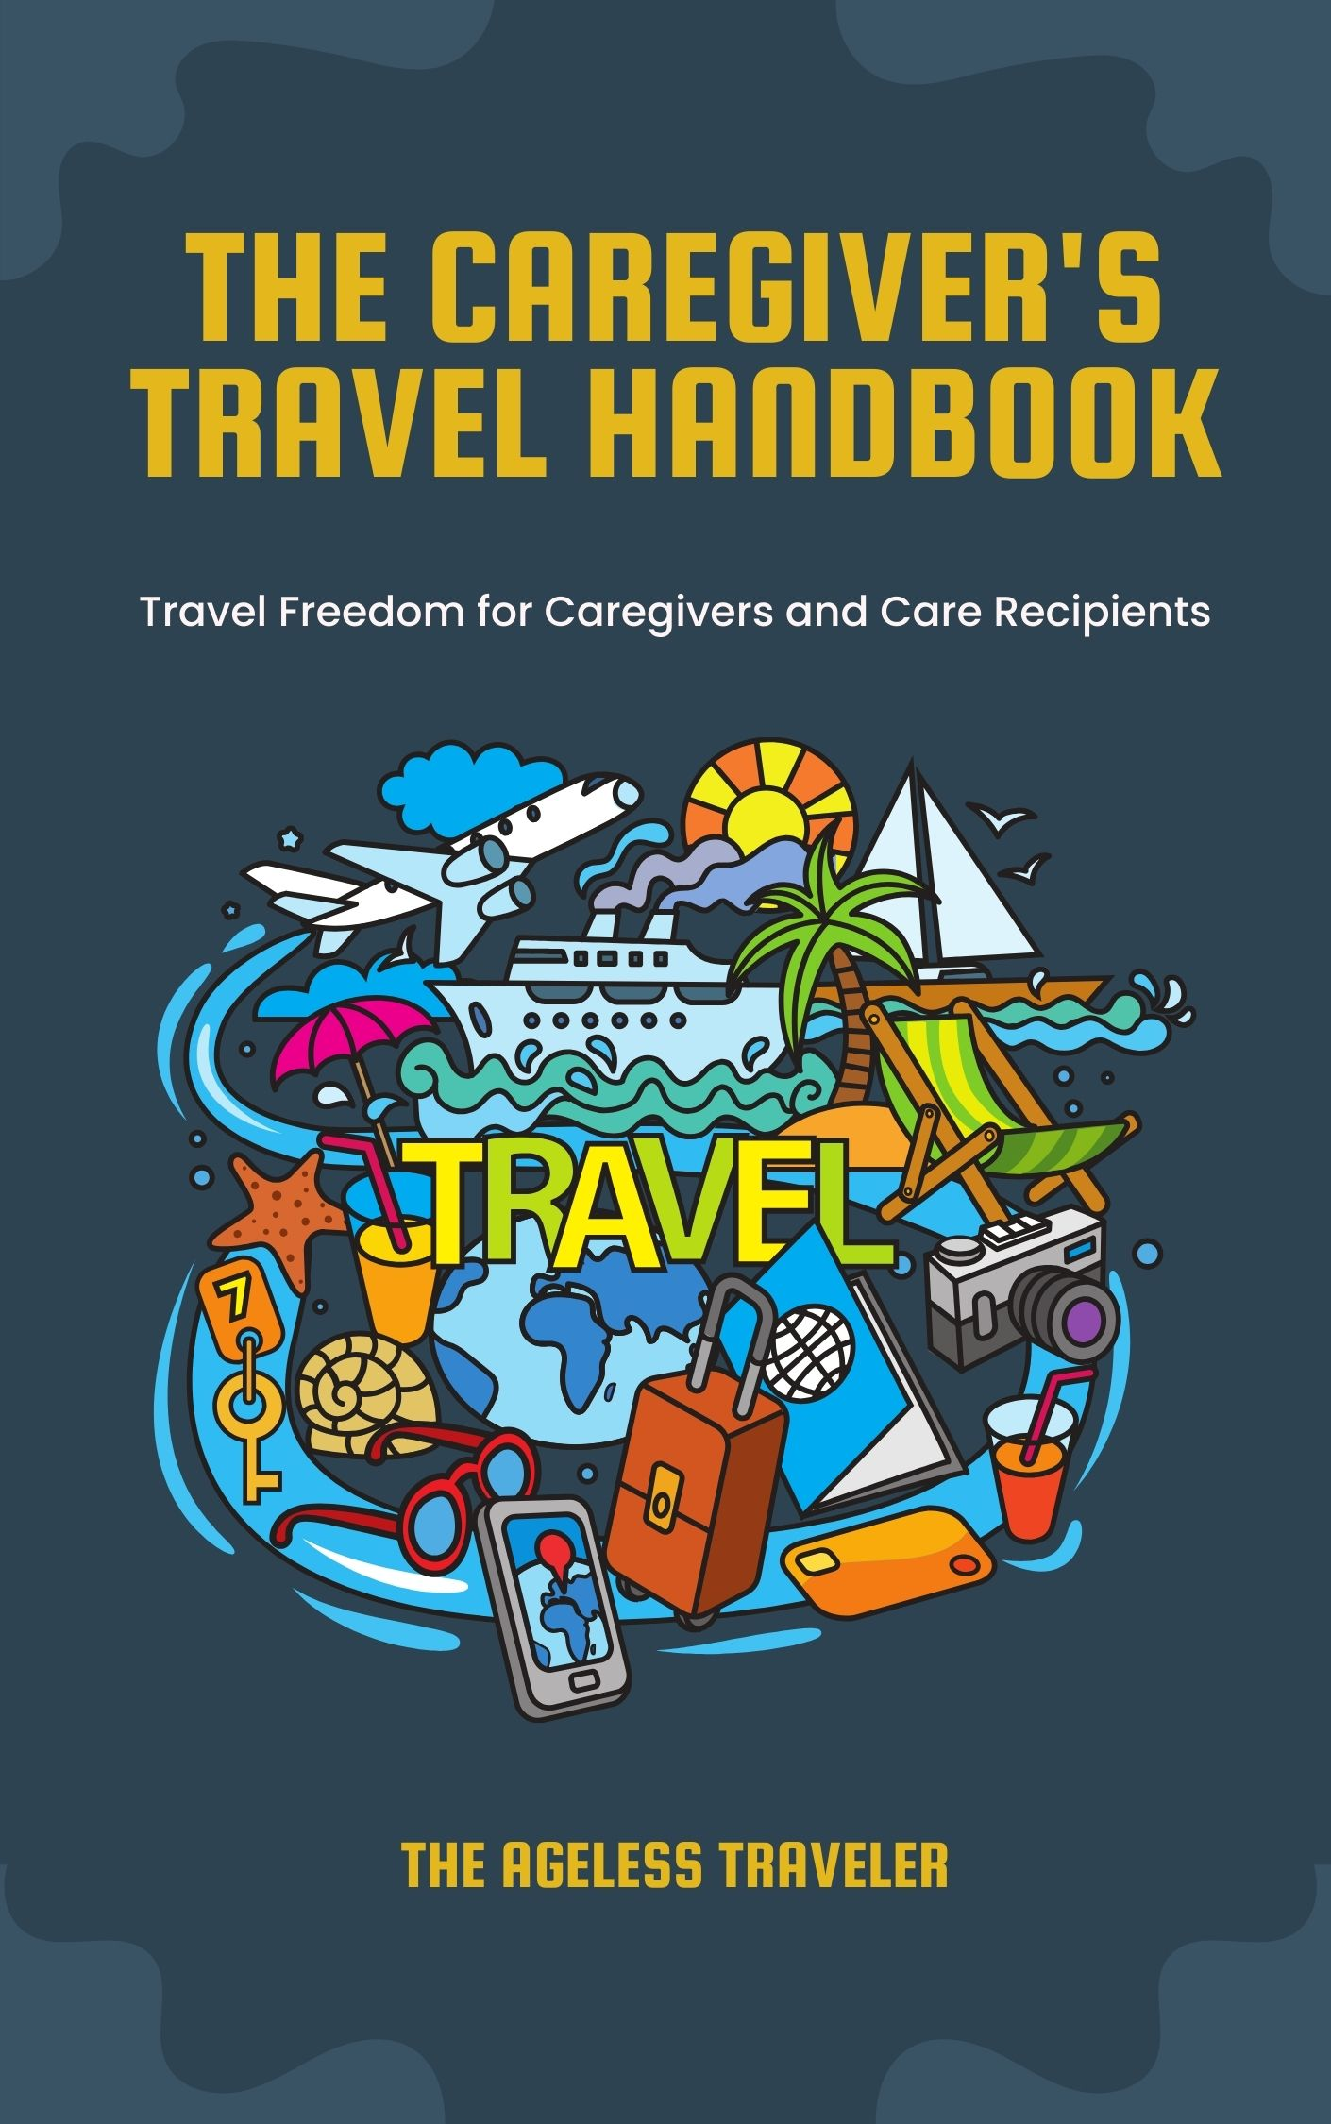


Slide 2
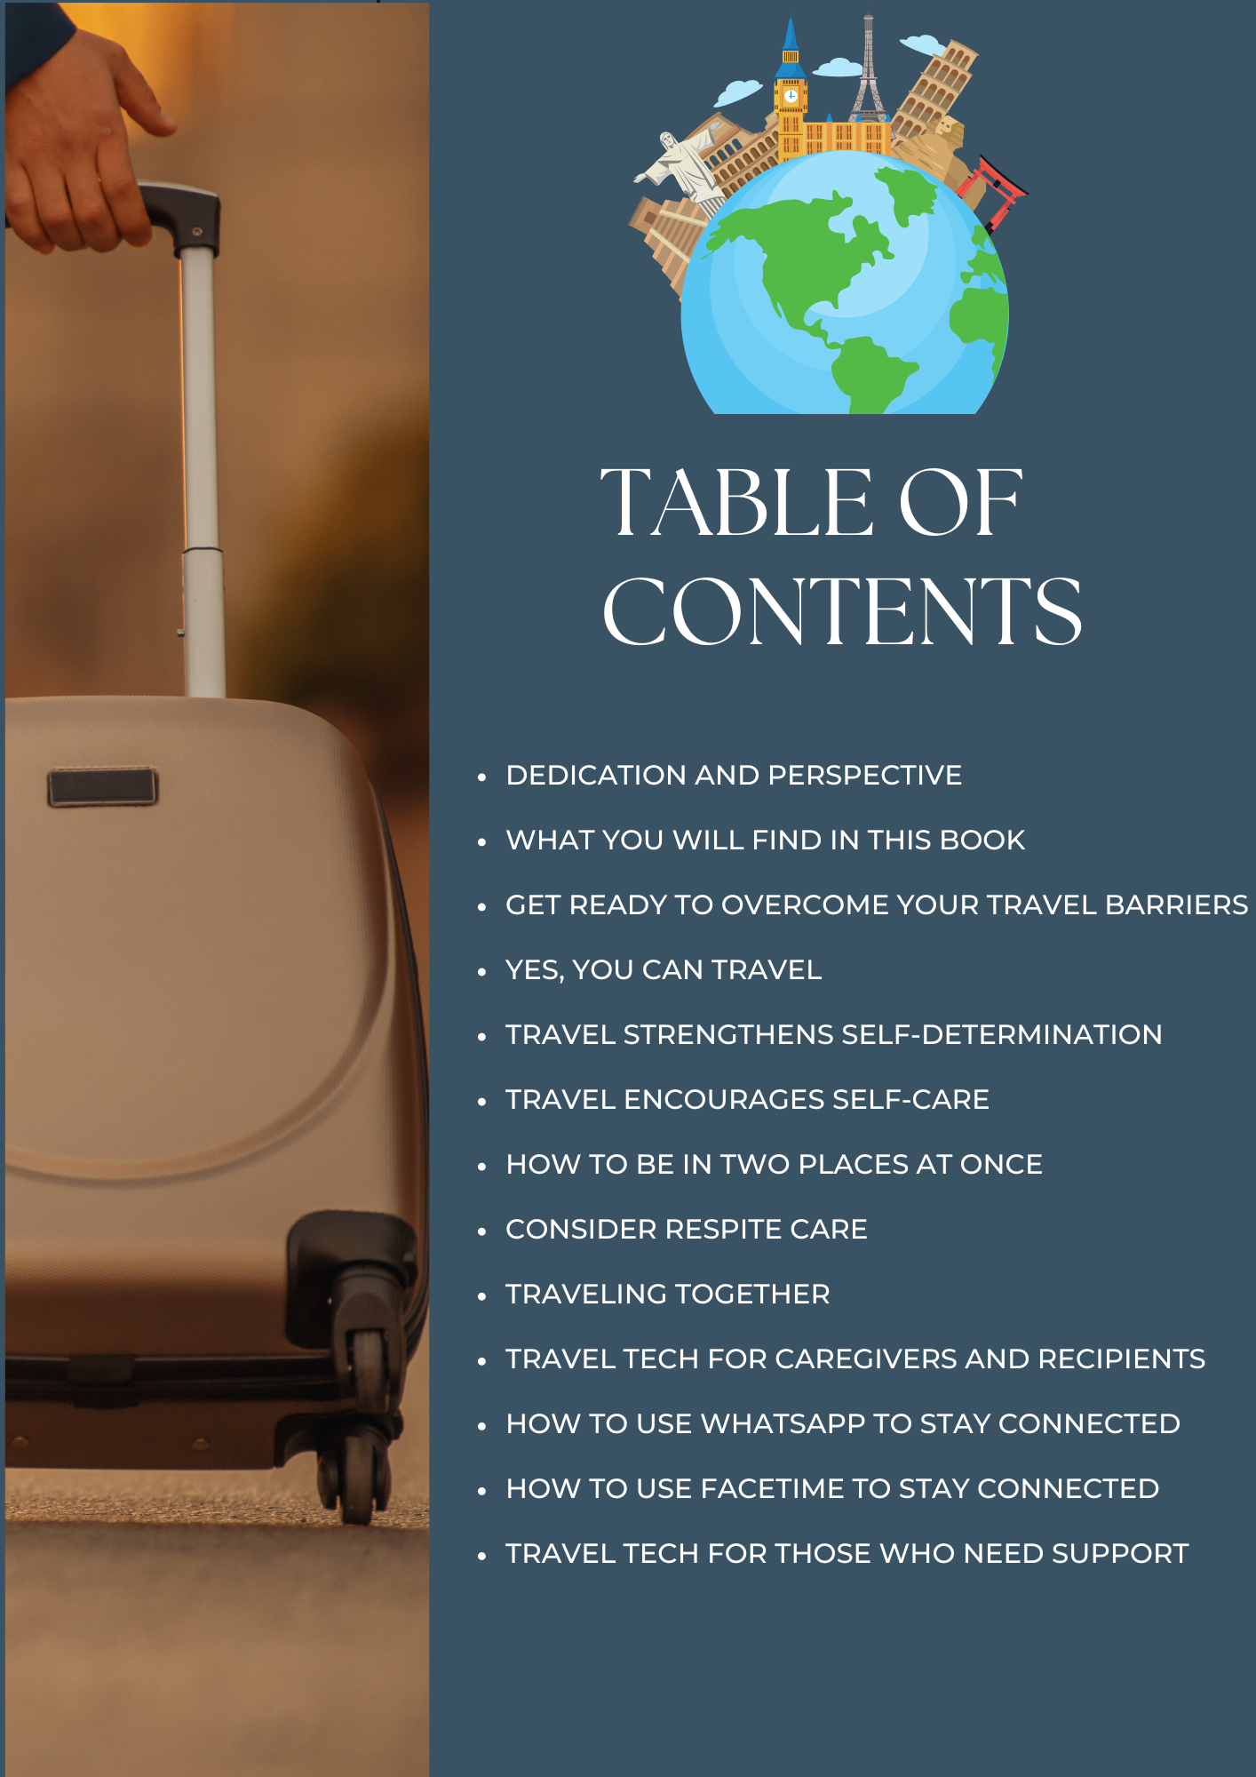
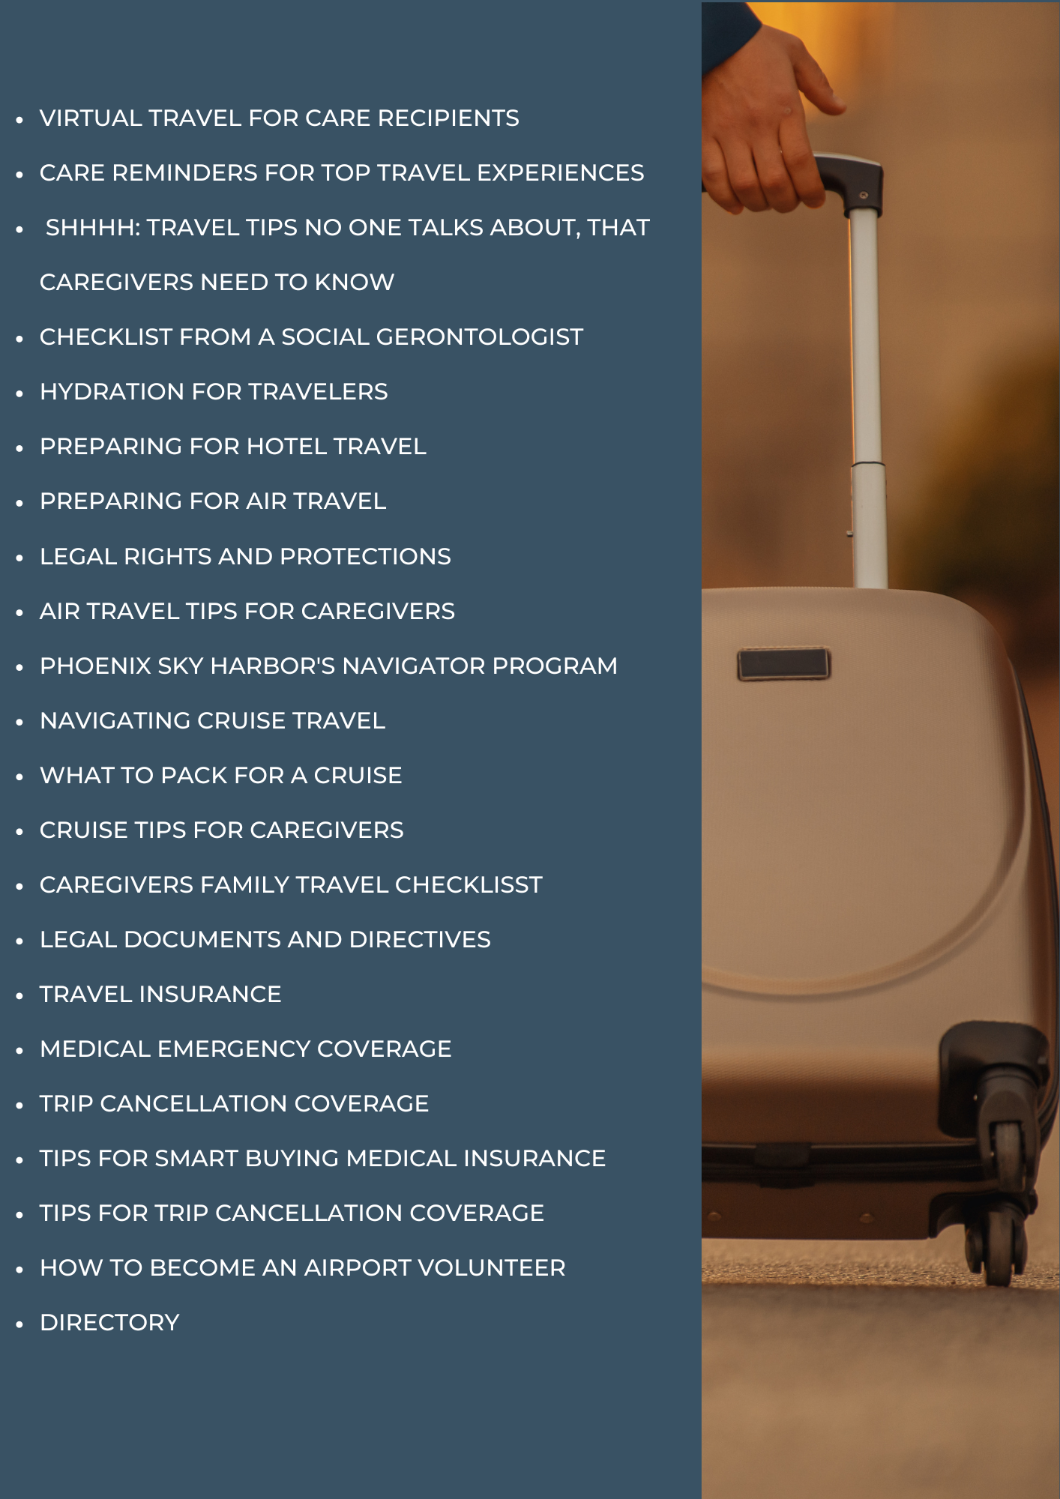

Slide 3
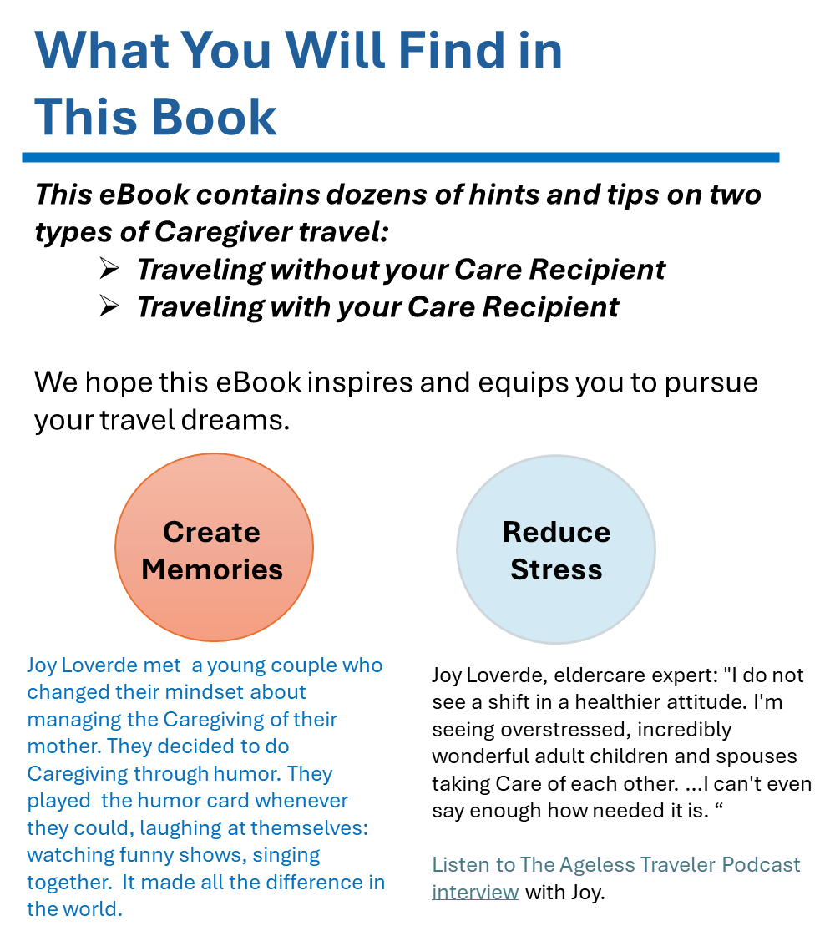
Dedication
This eBook is dedicated to the incredible children, spouses, friends, neighbors, and all those who are Family Caregivers. You inspire each other and the world. May this book empower you to celebrate yourselves and your loved ones with the ultimate gift — the freedom to explore our awe-inspiring world.
The Ageless Traveler's Perspective
The Ageless Traveler is committed to championing every individual's journey to discover the world, identifying obstacles, and offering solutions. Among these challenges lies the noble responsibility of Caregiving, which often hinders travel precisely when the desire and opportunity arise. Not on our watch! Often, care recipients yearn to travel, yet they require the support of their dedicated caregivers. You, too, embody the spirit of The Ageless Traveler. By enabling caregivers to travel alone or alongside care recipients, we unlock lifelong travel for those often overlooked.
Years ago, during a journey through Australia, I met a woman facing early-onset Alzheimer's. I quietly sought her travel advice, to which she replied with a radiant smile, "Take the hard trips first." Her words and warmth have stayed with me ever since. My mission is to make every journey seamless or at least more manageable. Through this eBook, may we honor the Ageless Traveler's creed:
Never Stop Traveling!

Slide 4
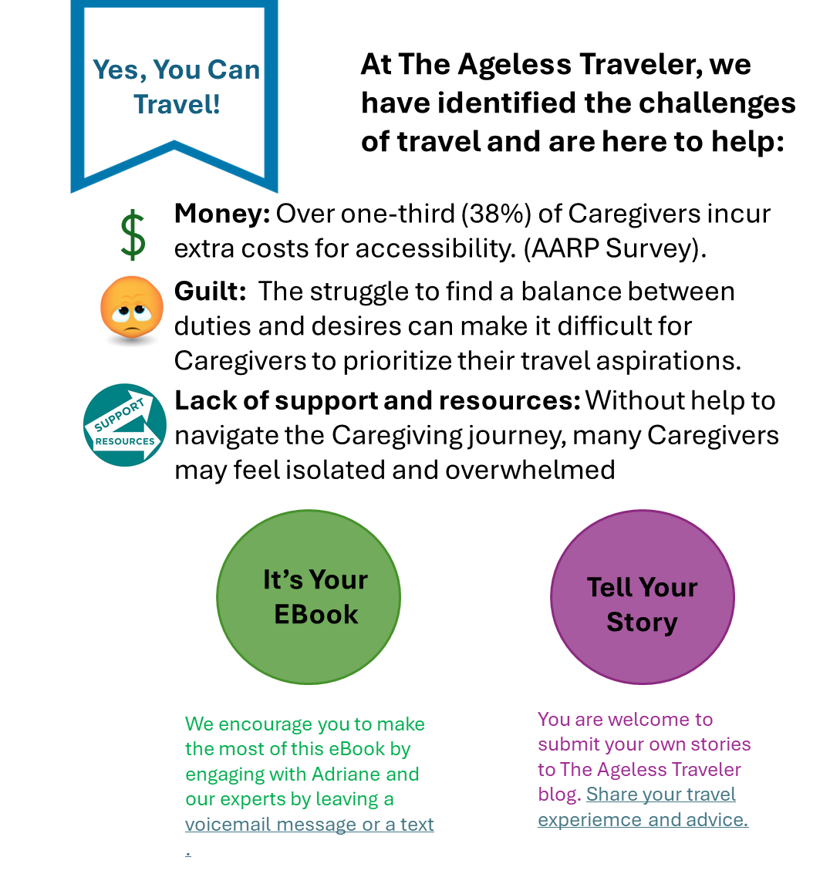

Get Ready To Overcome Your Travel Barriers
Travel Makes You A Better Caregiver
Travel is not just a luxury; it is essential for mental health, physical well-being, and spiritual rejuvenation. Maintaining your health and well-being directly impacts the quality of Care you can provide. Postponing travel indefinitely due to Caregiving responsibilities can lead to burnout and stress
Travel Makes You A Better Care Recipient
It's a big world, and when you have challenges, your world can get as small as your worries and fears. Traveling takes you out of yourself, as does your generosity in graciously giving your Caregiver a chance to travel.
What's different about The Ageless Traveler Podcast? We tell it like it is. We cover topics no one discusses…but we do!

Slide 5

Travel Strengthens Self-Determination
Travel Transforms
For spouses and partners of individuals with Dementia, Parkinson's, Alzheimer's, or other age-related conditions, self-determination is essential in maintaining a sense of purpose and identity. By taking the time to prioritize your own needs and desires, you can better support your loved one and ensure that both of you can navigate the challenges of Caregiving together.
Relax
One of the key benefits of traveling as a family Caregiver is the opportunity for Respite and relaxation. Caregiving can be physically and emotionally draining, so having a change of scenery can provide much-needed relief. Traveling allows Caregivers to take a break from their responsibilities and focus on enjoying themselves and creating positive experiences with their loved ones.
Traveling Encourages Self-Care
You Need a Breather: Traveling provides an opportunity to break away from the daily routine and explore new surroundings.
Taking a trip alone or together can be rejuvenative.
What Is Self-Determination?
Self-determination indicates the ability to control your own life, be self-motivated, and grow in fulfillment.
This definition was promoted as a premise of good mental health by psychologists Edward Deci and Richard Ryan, in their 1985 book Self-Determination and Intrinsic Motivation in Human Behavior.
They developed a theory of motivation that suggests people tend to be driven by a need to grow and gain fulfillment.
Self-determination is vital to maintaining a sense of autonomy and independence while providing Care for a loved one. Caregiving is not a one-size-fits-all role, and by embracing self-determination, you can tailor your Caregiving approach to meet the specific needs and preferences of your loved one. This can help to foster a sense of empowerment and fulfillment in both you and your loved one.
Traveling Builds Self-Determination
Self-determination plays a crucial role in Caregiving, especially when it comes to caring for senior family members or loved ones with chronic illnesses, mental health conditions, or physical challenges.
The ability to make choices and decisions about one's Care and the Care of others is essential in providing the best possible support and assistance. As a Caregiver, it is important to empower yourself and your loved one by embracing self-determination in all aspects of Caregiving
Boost Confidence
Caregivers may feel restricted by their Caregiving duties, but traveling can help them regain a sense of control over their lives, which can boost their confidence and self-esteem.
Traveling with your Care Recipient or sharing your travel stories with them can be a fulfilling and enriching experience for both the Caregiver and the Care Recipient. It can strengthen your relationship, provide much-needed Respite, promote independence and empowerment, and offer opportunities for personal growth and learning. By embracing the benefits of traveling, you will navigate your Caregiving journey with a renewed sense of purpose and self-determination. For more on this visit visual historian, Martie McNabb.

Slide 6


How to Be In Two Places At Once
Joy Loverde is a popular keynote speaker and best-selling author.
Visit her website for tips and resources for caregivers and for people who live alone.
You will need to have the utmost Care for your loved one while you are traveling.
Here is the hierarchy of Care protocols depending on where the Care Recipient is staying and the level of Care they require while you are traveling.
1
If Your Loved One is Living Independently: The old-fashioned method of getting to know your elders' friends and neighbors is nothing less than a lifesaver. Introduce yourself. Exchange contact information. Make sure their friends have full access to get into your parent's.
2
3
4
Create a Formal or Village Care Team: These networks provide social activities, vetted resources, and mutual assistance, including temporary Caregiving. For more…
The Complete Eldercare Planner, 4th Edition offers tips on how to share the care. A must-read before you travel.
Meet Joy on The Ageless Traveler Podcast and YouTube Channel.
Make a list. Decide what kind of specific help you need and write it down. If anyone ever says to you, "What can I do?" let them pick from your list. Update your list .
Create an informal Care team. Make a list of people who can help you: siblings, friends and neighbors, and community volunteers
5
6
Use Technology. Besides using the telephone to check in, download apps, and monitor with cameras. Of course, you'll have to check ahead of time how willing your loved one is to be observed from time-to-time
Identify a Network of Professionals. ElderCare services are a telephone call away. These include: Visiting nurses, case managers, transportation providers, bathing services, legal and financial advisors, and others.
For more details on these and other resources, check out the Directory at the end of this ebook.

Slide 7



Consider Respite Care
Our expert, Star Bradbury, is a member of the Aging Life Care Association or ALCA. She advises families to find a Certified Geriatric Care Manager who has deep experience in Respite Care planning. Access Star’s Podcast and YouTube
Respite Care is temporary Care that gives Caregivers a break from day-to-day responsibilities. Respite Care is offered through assisted living, senior residences, and other residential settings for people living at home on a temporary basis when their usual Caregiver is traveling.
Finding Respite Care options can provide you with the opportunity to take a break and recharge, allowing you to continue providing quality Care for your loved one. There are a variety of Respite Care options available for Caregivers, so it is crucial to explore what works best for you and your unique situation.
From Geriatric Care Manager Star Bradbury. "I want to say how important it is for Caregivers to give themselves things to look forward to. I watched it with my parents. My stepdad took Care of my mom for years. He let his health fail with drastic outcomes in the end, even though my mom passed away before he did. Yes, Caregivers ignore their health. That's why I want to support your readers who are saying I can't travel. I want to hold their hand, look you into their eyes, and say, Yes, You Can. Will it take some extra planning? Will it take a little bit of letting go? Yes, but you cannot hold on to the belief, mistakenly, that you are the only one who can meet your loved one's needs.
Want to get away for a day? One Respite Care option is adult day programs, where your loved one can spend time in a safe and stimulating environment while you take a break. These programs offer a variety of activities and socialization opportunities for seniors, providing them with a chance to engage with others and stay active. Adult day programs can be an excellent way for Caregivers to have some time to themselves while knowing their loved one is safe.
Need more Care? Respite Care can also be found in assisted living facilities or nursing homes, where your loved one can stay for a brief period while you take a break. These facilities offer round-the-clock Care and support, ensuring that your loved one's needs are met while you have some time to relax and recharge. While it can be challenging to consider placing your loved one in a facility, Respite Care can be a valuable resource for Caregivers who need a more extended break from their Caregiving duties.

Slide 8



Traveling Together
Carol Sargent is a leading travel planner for people with Dementia and their Caregivers. Access her expertise from our website, podcast, and YouTube link.
Travel with a Care Recipient with cognitive or physical issues is becoming popular. Advanced medicine, technology, and innovative support services all contribute to making travel possible.
If you think you can't travel, our experts say you can. Here are reasons to inspire you to put in the effort.
  •Traveling with a Care Recipient enhances Caregiving skills by promoting adaptability and flexibility.
  •Caregivers often face unexpected challenges and changes in their daily routines, and traveling requires them to master unfamiliar environments and situations.
  •When you travel alone and have cognitive challenges, you learn to problem-solve creatively and adapt to new circumstances quickly, all of which are valuable skills when you get home.
  •Everyone gains new perspectives and insights while they travel. Experiencing diverse cultures, meeting new people, and exploring diverse landscapes can broaden your understanding of the world and your role as a Caregiver or Care Recipient. This exposure to innovative ideas and ways of life can inspire you to approach your day-to-day life with fresh eyes and an open mind.
Traveling TOGETHER can strengthen the bond between Caregivers and their loved ones, fostering deeper connections and creating lasting memories. Sharing new experiences, overcoming challenges together, and exploring unfamiliar places as a team can create a sense of unity and shared purpose. These shared experiences can also provide opportunities for growth, learning, and mutual support within the Caregiving relationship.

Slide 9

Everyone benefits by getting more tech-savvy, whether traveling with you, staying home, or traveling alone with mild Dementia. Travel requires tec use in ways you may not have considered before. Examples: using a language translation app to communicate with locals, a GPS app to navigate unfamiliar streets, or a mobile banking app to manage finances while on the go. These real-life scenarios can help you see the practical benefits of technology and motivate you to continue learning and adapting to new digital tools.
Caregiver travel provides a unique opportunity to support and guide Care Recipients in building their technology skills. By being available to troubleshoot any issues or provide guidance as needed, Caregivers can help Care Recipients feel more confident and empowered in using technology.
Family Caregivers traveling with a Care Recipient with a chronic illness, mental health condition, or physical disability can harness technology to ensure their safety, comfort, and well-being during the trip. Caregivers can use technology to monitor medication schedules, track symptoms, communicate with Healthcare providers, and access resources and support services while on the road. By incorporating technology into their travel plans, Caregivers can help Care Recipients manage their health effectively and enjoy a smoother and more enjoyable travel experience.
Travel Tech For Caregivers and Recipients
From medication management apps to telehealth services, there are a variety of tech tools available to help you travel. By embracing these technologies, you enhance your ability to give Care and ensure a smoother travel experience for yourself.
Discover unique Travel Tech resources and access our favorites with discounts for you
How Travel Enhances Technology Skills
Many of us feel intimidated by technology. By exposing yourself to different devices and applications while on a trip, you become more comfortable and proficient in using them.
Whether it's navigating a smartphone for directions, using a tablet to stay connected with loved ones, or learning how to use a new app for translation or currency conversion, travel provides a hands-on opportunity for seniors to practice and improve their technology skills.
Navigation Apps: One way in which travel can enhance your technology skills is by using navigation apps and GPS systems. Navigating unfamiliar streets and transportation systems in a foreign country can be daunting, but with the help of GPS technology, you can easily find your way around.
2
3
Document Storage: Motivity is our go-to place for Healthcare, power of attorney, and all other documents for online storage, inducing directives, and Care journals. "My husband and I would not think of traveling without Motivity." Adriane Berg
Caregiver Apps: help streamline communication and organization. These apps allow Caregivers to coordinate schedules, track medications, and communicate with other family members or HealthCare providers. By having all relevant information in one place, Caregivers can ensure that nothing falls through the cracks and that their loved one receives the best possible Care.
GPS tracking devices can provide peace of mind and added security. These devices can help Caregivers keep track of their loved one's whereabouts, especially in unfamiliar environments. If they become separated, GPS tracking devices can quickly locate them.
Telehealth Services allow for remote medical consultations and monitoring. These services can save time and energy making it easier for you to manage responsibilities while still providing top-notch Care.

Slide 10




Understanding the Interface:
Show them the main screen:
  ▪Chats: Where conversations are listed.
  ▪Calls: Where they can make voice and video calls.
  ▪Contacts: Where all their WhatsApp contacts are listed.
Adding Contacts
- WhatsApp uses your phone's contact list. Make sure the loved one's phone number is saved in your contacts.
- Go to WhatsApp and tap the chat icon to start a new chat. Select the contact you want to message or call.
Select a contact or enter a phone number to start a conversation.
How to start a new chat:
▪ Tap on the pencil icon or the "+" icon.
Sending a Message:
- Open WhatsApp.
- Tap the chat icon and select the contact.
- Type your message in the text box and tap the send button (paper airplane icon).
How to send photos, videos, and voice messages:
▪ Tap on the attachment icon (paperclip) in the chat.
▪ Select the type of media they want to send.
Making a Voice Call
- Open WhatsApp and select the contact.
- Tap the phone icon in the top right corner to start a voice call.
Making a Video Call:
- Open WhatsApp and select the contact.
- Tap the video camera icon in the top right corner to start a video call.
How to Use WhatsApp to Stay Connected While Traveling
WhatsApp and FaceTime are two popular apps that make it easy to connect through video calls, voice calls, and messaging.
Here's a brief guide to help you master these apps and explain how to use these apps to a loved one who is staying at home or traveling with you.
Setting Up WhatsApp
Download and Install WhatsApp:
**For iPhone**
- Open the App Store.
- Search for "WhatsApp."
- Tap "Get" and then "Install.“
**For Android:**
- Open the Google Play Store.
- Search for "WhatsApp."
- Tap "Install."
Set Up WhatsApp
- Open WhatsApp.
- Agree to the terms and conditions.
- Enter your phone number and tap "Next."
- You'll receive a verification code via SMS. Enter this code to verify your number. Set up their profile by entering their name and adding a profile picture if you like. This is how their contacts will see them on WhatsApp.

Slide 11

Tips for Explaining Tech to a Loved One
Write Down Instructions.
Provide a written guide with simple instructions for them to refer to if they get confused.
Include screenshots if possible.
Make a few practice calls and send messages while you are together to ensure they are comfortable using the apps.
Encourage them to ask questions and practice until they feel confident.
Reassure them that it's okay to make mistakes and that you can help them fix any issues.
Let them know you'll be available to guide them if they need help while you're traveling.
Anticipate common issues (e.g., forgetting passwords, not receiving verification codes) and have solutions ready.
Show them how to contact WhatsApp support if needed.
How to Use FaceTime to Stay Connected While Traveling
WhatsApp and FaceTime are two popular apps that make it easy to connect through video calls, voice calls, and messaging.
Here's a brief guide to help you master these apps and explain how to use these apps to a loved one who is staying at home or traveling with you.
Setting Up FaceTime
Ensure FaceTime is Enabled
- Open the "Settings" app on your iPhone or iPad.
- Scroll down and tap "FaceTime."
- Make sure FaceTime is turned on.
-You might need to sign in with your Apple ID.
Making a FaceTime Call
- Open the "FaceTime" app.
- Tap the “+” button in the top right corner.
- Enter the name, email, or phone number of the person you want to call.
- Tap "Audio" for a voice call or "Video" for a video call.
Using FaceTime
- Open the "Contacts" app or the "Phone" app and find the contact.
- Tap their name, then tap the "FaceTime" icon (either video or audio) to start the call.

Slide 12

Communication Tech: Phone apps provide information on accessible travel destinations, transportation options, and accommodations, as well as real-time updates on accessibility features and services. Some apps offer virtual tours of hotels, attractions, and other travel destinations to help individuals plan their trips more effectively.
Travel Tech For Those Who Need Support
For more details on these and other resources, check out the Directory at the end of this ebook.
Mobility Tech: One of the most helpful technological solutions for travelers with physical disabilities is the use of mobility aids such as wheelchairs, scooters, and walking aids. These devices can significantly enhance the independence and mobility of individuals with disabilities, allowing them to navigate airports, train stations, and other travel destinations with ease. Many airports and travel hubs also offer accessibility services such as wheelchair assistance and accessible transportation options to accommodate travelers with disabilities.
Monitoring Tech: Remote monitoring devices and GPS trackers can provide peace of mind and enhance safety while traveling. These devices can help Caregivers keep track of their loved ones' whereabouts, monitor their health and well-being, and communicate with them in case of emergencies.
The Ageless Traveler experts can guide you through technology, from equipment to consulting.
Please email us to access our experts.
Sensory Tech: For those with sight or hearing impairment, there are assistive devices such as hearing aids, communication devices, and vision aids. These devices can help individuals with sensory impairments communicate, navigate their surroundings, and access information while traveling.

Slide 13

Virtual Travel For Care Recipients
Virtual travel for Care Recipients has the potential to revolutionize the way we think about Travel and Caregiving.
By embracing this innovative approach, Caregivers can provide their loved ones with enriching and fulfilling experiences that promote mental and emotional well-being.
As the world continues to evolve and adapt to modern technologies, virtual travel will become an increasingly valuable tool for Caregivers seeking to enhance the quality of life of their Care Recipients.
Explore global cultures with twice-weekly live-streamed guided walks. Our Award-Winning Travel Club for armchair explorers allows individuals and groups to enjoy live, guided tours in 100+ cities from the comfort of their homes or communities.
Virtual tours are interactive and dynamic, led by our eighty-seven passionate local storytellers.
Each tour is unscripted, unedited, and immersive, ensuring "Wow" moments, where you can ask live questions and enjoy shared local recipes, maps, music, books, and movies together with other like-minded travelers.
Ready to find out more? Visit Ageless Traveler for discounts on Wowzitude and livestream travel for Your Loved Ones.
Travel agents, tour operators, and hotels can play a crucial role in supporting virtual travel for Care Recipients and Caregivers by offering specialized packages and services that cater to this unique market. By partnering with The Ageless Traveler and World Tourism Network's Ageless Tourism Program, travel providers can create immersive and engaging actual and virtual travel experiences that are specifically designed for individuals with health concerns or limitations.

Slide 14

Care Reminders for Top Travel Experiences
Listen to the Ageless Traveler CareGiver Series of interviews:
Joy Loverde
Carol Sargent and
Star Bradbury
Shhhh:
Travel Tips No One Talks About, That Caregivers Need To Know
I once asked Warren Buffet at a press conference, "What makes you such a great investor?" His simple answer, "I Pay Attention!" Paying attention to the details of travel is the ONLY thing you need to travel well and make the experience happy for all."
Here are the essentials for THOUGHTFUL travel with loved ones and even for yourself. We all know them. But we all forget in the rush of travel preparation.
Look for hotels or resorts that are senior-friendly and offer amenities such as wheelchair accessibility, grab bars in bathrooms, and easy access to medical services if needed. It may also be helpful to request a room on the ground floor or near an elevator to minimize the need for stairs.
Pack a travel kit with essential items such as medications, medical supplies, comfortable clothing, and any mobility aids that your senior family member may need.
Be patient and understand your senior family members' needs and limitations. Take frequent breaks, allow for rest periods, and adjust your itinerary as needed to accommodate their comfort and well-being.
Make a checklist of medication schedules, dietary restrictions, and any other concerns that may arise during the trip. Pack essential medical supplies, including medications, medical equipment, and any necessary documentation (such as medical records or prescriptions). Make sure these items are easily accessible during your journey and have a plan in place for refilling prescriptions or seeking medical assistance if needed.
Determine where to get medication refills and other supplies in case they are lost, stolen, or you run out.
Continency Culture: Don't let incontinence stop or limit your travels. There are incontinence products specifically designed for long-distance travel and Bathroom Apps that save your sanity
Money: You can reduce travel costs and still go in style. Download The Ageless free eBook LuxuryTravelForLess
Prevent Air Stress: If you are traveling with a loved one, fly direct OR take our tip and fly with an airline that offers free stopovers for a day or two.
Clothing can help you manage pain. Reduce pain with wearables. Check out Intelligent Threads.
Pack a Back Strap: If you are pushing a wheelchair, totting more luggage, or doing more manual work this can prevent back strain.
Prevent Wandering: Make sure your companion has an identification bracelet or carries an I.D. card with their name, your contact information, and any relevant medical details.

Slide 15
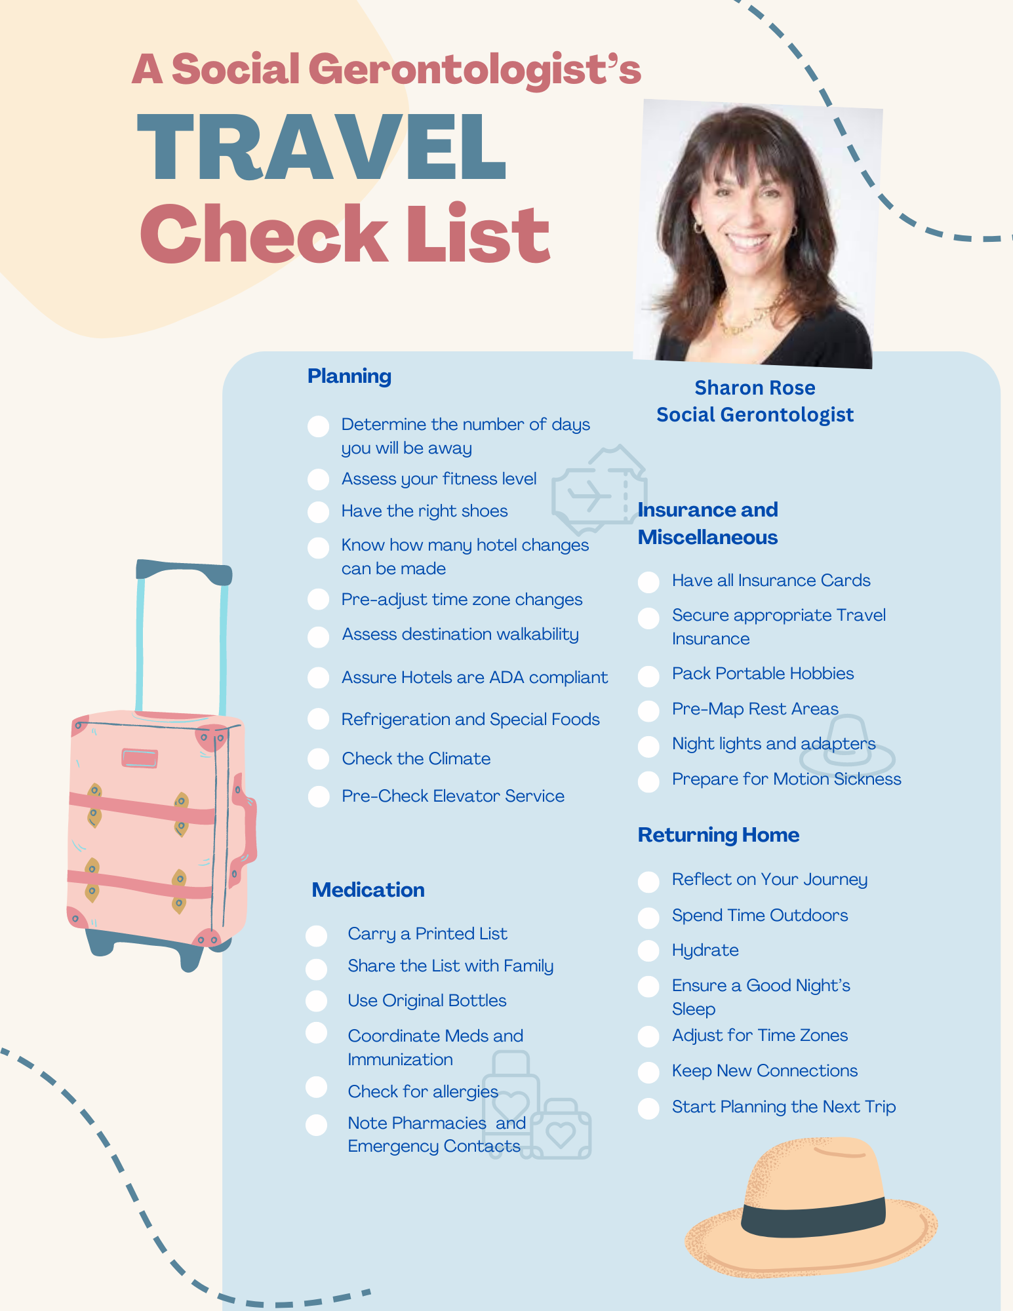
Join the Ageless Traveler Facebook Salon
Get Our Free Materials by Email
There are countless Facebook groups, but this one is truly transformative.
If you're over 60 and passionate about travel, our group will change your life by helping you travel better, overcome barriers, and access exclusive travel discounts.
  Connect with fellow travel enthusiasts.
  Find solutions to your travel challenges.
  Discover exciting new destinations.
Visit The Ageless Traveler website.
See all we have to offer and join from our home page.
Don't use Facebook? No problem!
Visit our Contact Page and leave your email. You'll receive free notifications about trips, eBooks, podcasts, travel discounts, and more.

Slide 16


5
6
7
Make Drinking Easy and Accessible
Frequent Breaks: Schedule frequent breaks during your travel to offer drinks.
Accessible Drinks: Always keep drinks within reach, whether you're in a car, at an airport, or exploring outdoors.
Encourage Small, Frequent Sips
Regular Sips: Encourage your companion to take small sips of water regularly rather than drinking copious amounts at once.
Fun Straws and Cups: Use colorful or fun straws and cups to make drinking more enjoyable and engaging.
Monitor for Signs of Dehydration
Symptoms: Be aware of signs of dehydration, such as dry mouth, confusion, dizziness, dark urine, or decreased urination.
Immediate Action: If you notice any symptoms of dehydration, encourage fluid intake immediately and seek medical attention if necessary.
Hydration for Travelers
Hydration plays a key role in many of our body's functions, including bringing nutrients to cells, getting rid of wastes, protecting joints and organs, and maintaining body temperature. Water should almost always be your go-to beverage.
1
Monitor Fluid Intake Regularly
Set Reminders: Use alarms or reminders on your phone to prompt you to offer drinks at regular intervals.
Keep track: Maintain a log of how much your companion is drinking to ensure they are consuming enough
8
9
10
Incorporate Hydration into Daily Routine
Morning Hydration: Start the day with a glass of water.
Hydration Schedule: Create a hydration schedule and stick to it.
Consult HealthCare Providers: Speak with Healthcare providers for personalized advice and recommendations on hydration strategies.
Pack Hydration Essentials
Cooling Towels: Use cooling towels to help lower body temperature and reduce the risk of dehydration.
Pack electrolyte drinks or powders to help maintain electrolyte balance, especially during extended periods of heat exposure.
Proper Clothing
Dress your companion in lightweight, breathable clothing to help regulate body temperature and reduce sweating. link
2
3
4
Make Drinking Easy and Accessible
Frequent Breaks: Schedule frequent breaks during your travel to offer drinks.
Accessible Drinks: Always keep drinks within reach, whether you're in a car, at an airport, or exploring outdoors.
Offer a Variety of Hydrating Options
Water: Plain water is the best choice. Always have a bottle of water handy.
Flavored Water: Some people may prefer water with a bit of flavor. Consider adding slices of fruit, cucumber.
Hydrating Foods: Offer foods with high water content, such as watermelon, cucumbers, and oranges.
Use Hydration Aids
Water Bottles: Choose easy-to-use, spill-proof water bottles that your companion can handle comfortably.
Hydration Packs: Consider using a hydration backpack with a built-in water reservoir and drinking tube for easy access.

Slide 17


Preparing for Hotel Travel
Five Hotel Functions to Be Aware Of
1
2
3
The Concierge
If you plan to sightsee, is there a concierge that can save you from waiting in line for tickets, get accessible seats at theatres, and guide you to accessible transportation?
Management on Duty
How big is the staff, how is it structured, especially in the evenings and after hours? What are the protocols? What do we do if we have an emergency? How close is the nearest hospital? Is there a hotel doctor?
Security
If traveling alone or with someone vulnerable, always inquire about a hotel’s security department. If the security department is outsourced, they may have delineated tasks from which they do not vary. If security is a core part of management, there is often more flexibility in how they can respond to specific guest needs. Do they monitor guests or rely on housekeeping to observe odd guest behavior?
Best Destination for Rejuvenation
Spa and Wellness Resorts
Women’s Travel Specialists
Golf Resorts
Caregiver Respite Cruises
Lifelong Learning Trips
Music and Art and Theater Festivals
Safari and Nature Travel
4
5
Peter Anderson is a leading hotel and spa consultant, and on the Advisory Board of The Ageless Traveler. Listen to his Podcast Interview.
Food and Beverage
Can they accommodate dietary restrictions, food allergies, room service, and other special requests? Do they address food issues, including sugar-free, low salt, celiac, and dairy-free food allergies?
Accessibility
Understanding ingress and egress routes and emergency routes is essential for staff and guests. If there is a fire, is there help or just a loud alarm? Can The hotel provide first-floor guest rooms? What type of ventilation and temperature controls are offered?
Caregiver/Care Recipient Travel
Cruises
River Cruises
Theme Parks
National Parks
Visiting Family and Friends

Slide 18


Preparing for Air Travel
The BASICS OF AIR TRAVEL
  Research and understand the policies of the airline you will be flying with. Many airlines have specific guidelines for passengers using wheelchairs, walkers, or other mobility devices. It is essential to communicate your needs in advance and request any necessary.
  Familiarize yourself with the layout of the airport and plan your route from check-in to the boarding gate. Many airports provide services for passengers with disabilities, such as wheelchair assistance or priority boarding. Taking advantage of these services can make the airport experience more manageable for both the traveler and their Caregiver.
  Pack Right for air travel with mobility aids, it is crucial to consider the size and weight limitations of your mobility devices. Some airlines may require specific devices to be checked as baggage, while others allow them to be brought on board as carry-on itemsBe sure to pack any necessary accessories, such as chargers or cushions, to ensure the comfort and functionality of your mobility aid throughout your journey.
Advice From a Travel Pro
Caregiver and Dementia Travel Planner Carol Sargent, a Member of The Ageless Travel Advisory Board, advises:
  Discuss what anxieties you have about airports.
  Research smaller alternative airports.
  Select less busy flight times.
  Check out the volunteer assistance programs.
  Go through express security.
  Consider professional companion services.
Carol Sargent is a leading travel planner for people with Dementia and their Caregivers. Access her expertise from our website, podcast, and YouTube link.

Slide 19

If you or a travel companion have physical or cognitive challenges in navigating airports, you should know your legal rights.
4
Airport Services for Passengers with Dementia and Physical Disabilities
Many airports offer specialized services to assist passengers with Dementia or physical disabilities:
Wheelchair Services: Most airports provide complimentary wheelchair services. You can request this service when booking your flight or upon arrival at the airport.
Electric Carts: Larger airports often have electric carts to transport passengers with mobility issues across long distances within the terminal
5
The Transportation Security Administration
The TSA aids passengers with disabilities. Passengers can request help from a Passenger Support Specialist during the security screening process.
TSA Cares is a helpline (1-855-787-2227) that offers assistance and information for passengers with disabilities and medical conditions.
6
Assistance Programs:
Programs like the "Hidden Disabilities Sunflower" lanyard program help airport staff identify and assist passengers with hidden disabilities, including Dementia.
Quiet Rooms: Some airports have designated quiet rooms or areas where passengers with Dementia can rest away from the hustle and bustle of the terminal.
Navigating Air Travel: Legal Rights and Protections
Every country has different laws, but they are available through your chosen airline.
Here is the most relevant law for the USA.
1
Federal Law--Americans with Disabilities Act (ADA)
The ADA is a civil rights law that prohibits discrimination against individuals with disabilities in all areas of public life, including transportation and air travel. Under the ADA, airports must provide necessary accommodations to ensure that individuals with disabilities can access the same services as everyone else.
2
Federal Law--Air Carrier Access Act (ACAA)
The ACAA prohibits explicit discrimination in air travel based on disability. This law requires airlines to aid passengers with disabilities, including boarding, deplaning, and making flight connections. Airlines must also allow assistive devices on board and provide seating accommodations.
3
State Laws
Specific state laws can offer additional rights and services. For example, California's Unruh Civil Rights Act expands federal protections by prohibiting discrimination based on disability in business establishments, including airports. It's essential to check the local regulations of the state you are traveling from or to for any additional rights or services.

Slide 20
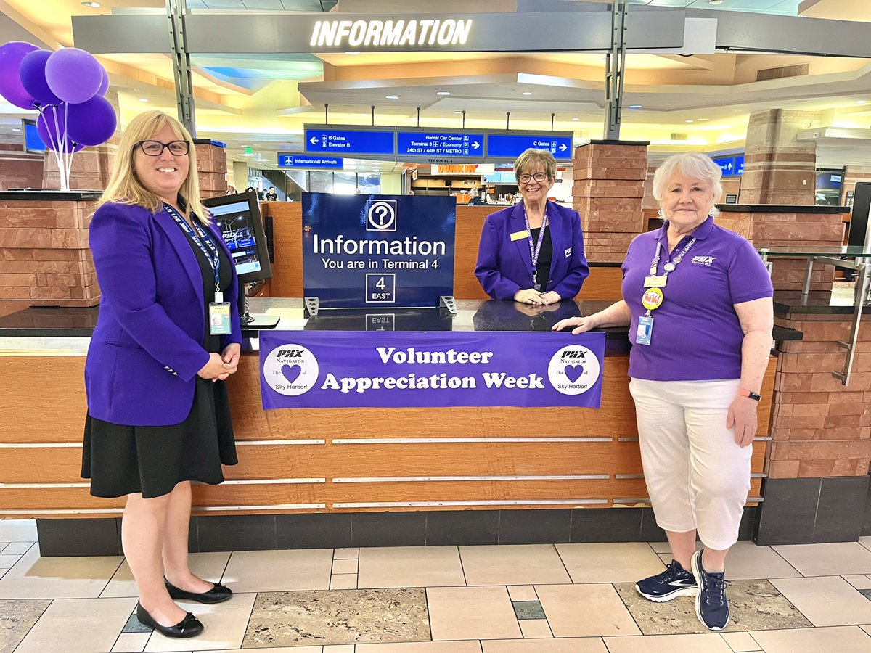
Air Travel Tips for Caregivers
SPOTLIGHT: Phoenix Sky Harbor's Navigator Program
1
Pre-Trip Preparation
Notify the Airline: Inform the airline about your companion's condition and request any necessary accommodations.
Prepare Documentation: Carry relevant medical Documentation, including prescriptions and doctor's notes, to facilitate the process if any issues arise.
Pack Smart: Bring essential items in your carry-on, including medications, snacks, a change of clothes, and comfort items for your companion.
Did you know that many airports have volunteer airport navigator programs designed to reduce stress for all travelers?
2
Sky Harbor's Navigator Program Volunteer Assistance Program, led by Misty Cisneros Contreras, engages volunteers from various professional backgrounds to assist travelers. They offer directions, answer questions, and cultivate a friendlier airport environment.
  "We provide opportunities for volunteers to provide directions, answer questions, greet people, send them farewell on their trips..." – Misty Cisneros Contreras.
The program, which started in 2000, has had volunteers, ranging from retired professionals to active workers. Volunteers serve as the first and last impression tourists get of their Arizona travels, aligning with the airport's goal of being "America's friendliest airport."
Planning and Utilizing Airport Resources Reduces Travel Stress
Alongside this innovative option, the airport provides a plethora of information on its website. This includes alternatives for dropping off passengers, sustainability tours, and even the acknowledgment of special programs for groups with additional stress factors, such as those traveling with Dementia.
At the Airport
Arrive Early: Arrive at the airport well in advance of your flight to allow ample time for check-in, security, and boarding.
Use Available Services: Take advantage of wheelchair services, electric carts, and TSA assistance to minimize stress and physical exertion.
Stay Calm and Reassuring: Maintain a calm demeanor to help your companion feel more at ease. Use simple language and provide reassurance throughout the journey.
The BASICS OF AIR TRAVEL
  Research and understand the policies of the airline you will be flying with. Many airlines have specific guidelines for passengers using wheelchairs, walkers, or other mobility devices. It is essential to communicate your needs in advance and request any necessary.
  2. Familiarize yourself with the layout of the airport and plan your route from check-in to the boarding gate. Many airports provide services for passengers with disabilities, such as wheelchair assistance or priority boarding.
  3. Pack Right for air travel with mobility aids, it is crucial to consider the size and weight limitations of your mobility devices. Some airlines may require specific devices to be checked as baggage, while others allow them to be brought on board as carry-on items
3
During the Flight
Seating Arrangements: Choose seats that provide easy access to the restroom and sufficient legroom. Inform the flight attendants about your companion's condition.
Stay Hydrated and Nourished: Ensure your companion stays hydrated and has access to snacks throughout the flight.
Monitor comfort: Check on your companion's comfort regularly and address any needs promptly.

Slide 21


Navigating Cruise Travel
Onboard Health and Medical Care
The cost and extent of onboard medical Care can vary significantly between cruise lines. Most ships have medical centers staffed by doctors and nurses who can handle a range of medical issues. However, it's crucial to understand the limitations and costs involved.
Many cruise lines offer accessible cabins, specialized dining options, and onboard medical services to accommodate passengers with disabilities or health concerns.
Caregivers should communicate these needs to the cruise line in advance to ensure a smooth and comfortable experience for their loved ones.
Special Needs at Sea
A company that provides mobility equipment, unique beds, oxygen, and other medical devices for cruise passengers offering a wide range of equipment rentals and sales to make cruising more accessible and comfortable.
Medical Facilities
Most cruise ships have basic medical facilities that can handle minor to moderate medical issues.
For severe cases, passengers may need to be evacuated to a land-based hospital.
Cost of Care
Medical Care on cruise ships is typically not covered by health insurance.
Costs can be high, so purchasing travel insurance that covers medical expenses and emergency evacuation is advisable.
Some cruise lines offer Respite Care services or specialized programming for individuals with memory loss or cognitive impairment.
Caregivers can also work with the ship's staff to create a personalized Care plan and ensure their loved one's safety and well-being throughout the journey.

Slide 22
What to Pack for a Cruise
Consider Cabin Safety
Choose a cabin in a quiet area of the ship to minimize confusion and disorientation. Use visual cues, such as photos or familiar items, to help your companion recognize the cabin.
Packing appropriately is essential to ensure a comfortable and stress-free cruise experience for your companion.
Here are some essential items to include:
Cruise Travel Rights and Protections
Medications and Medical Supplies
Pack all necessary medications in their original containers, along with a copy of the prescriptions. Include extra doses in case of delays. Bring any required medical equipment, such as hearing aids, mobility aids, and incontinence supplies.
Comfort Items
Bring familiar items that can help soothe and comfort your companions, such as favorite blankets, pillows, and Personal Care items.
Documentation
Carry all necessary Documentation, including passports, medical records, doctor's notes, and emergency contact information.
1
United Nations Convention on the Rights of Persons with Disabilities (CRPD)
The CRPD aims to protect the rights and dignity of persons with disabilities. It emphasizes the importance of accessibility and the provision of accommodations to ensure equal participation in society, including travel.
2
United States: Americans with Disabilities Act (ADA)
The ADA applies to cruise ships that operate in U.S. waters or are U.S.-flagged. It mandates reasonable accommodations for passengers with disabilities, ensuring access to facilities and services on board.
3
European Union: Regulation (E.C.) No 1177/2010
This regulation ensures that passengers with disabilities or reduced mobility have the same rights when traveling by sea and inland waterway within the E.U. It mandates assistance during embarkation and disembarkation and requires accessible facilities on board.

Slide 23
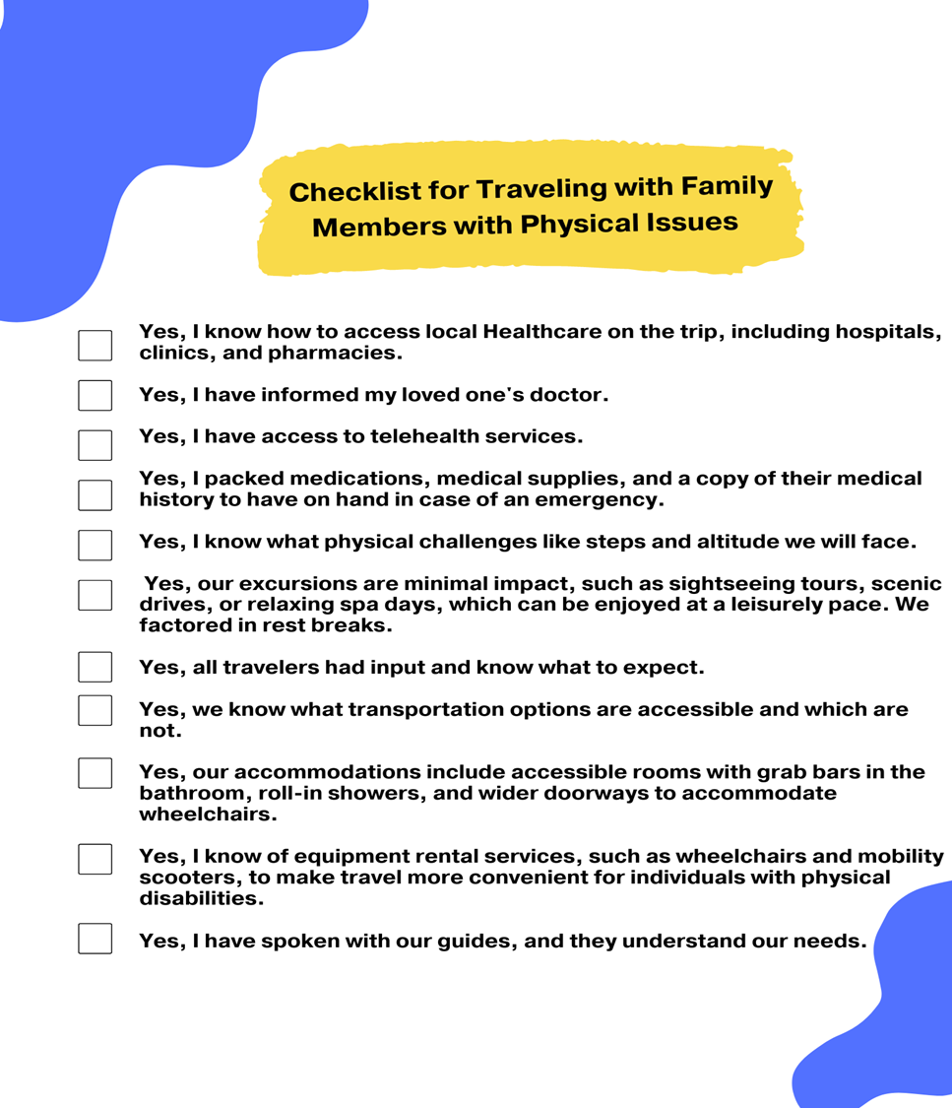
Cruise Tips for Caregivers
1
Pre-Cruise Preparation
Inform the Cruise Line: Notify the cruise line of your companion's condition and request any necessary accommodations. Many cruise lines have dedicated accessibility departments to assist with special needs.
Plan Shore Excursions: Choose shore excursions that are accessible and suitable for your companion's abilities. Many cruise lines offer accessible excursions specifically designed for passengers with disabilities.
2
On Board Strategies
Establish a Routine: Create a daily routine to provide structure and reduce anxiety for your companion. Familiar routines can be comforting for individuals with Dementia.
Engage in Activities: Participate in onboard activities that are enjoyable and suitable for your companion's abilities. Many cruise lines offer specialized activities for passengers with Dementia or disabilities.
3
Self Care for CareGivers
Take Breaks: Caring for someone with Dementia or physical disabilities can be exhausting. Take advantage of onboard Respite services or ask for help from other family members to ensure you get some relaxation.
Stay Connected: Join support groups or online communities for Caregivers to share experiences, tips, and support.

Slide 24


5
6
7
Advance Directives:
Legal documents that specify an individual's preferences for medical treatment and Care in the event they are unable to communicate their decisions.
Medical Records:
Documents containing a comprehensive history of an individual's medical conditions, treatments, and Healthcare visits.
Insurance Information:
Documentation of an individual's health insurance policies, including coverage details and provider contact information.
Legal Documents, Directives, and Health Information
1
Power of Attorney:
A legal document that grants a trusted individual the authority to make financial decisions on behalf of another person.
Types of Legal Documents with Definitions
3
4
Be Heard!
Take Our Course
Adriane Berg practiced Elder Law for 35 years and knows that as we age our wishes are often ignored.
We must Speak Out to healthcare providers, lawyers and family.
2
HealthCare Proxy:
Legal documents that appoint someone to make medical decisions for another person if they are unable to do so themselves.
Wills:
Legal documents that outline how a person's assets and property will be distributed after their death.
Trusts:
Legal arrangements in which one party holds property on behalf of another, detailing how and when the assets are to be transferred to beneficiaries.

Slide 25

Keep your and your loved one’s vital medical, legal and personal information secure and accessible 24/7 globally.
The Ageless Traveler has collaborated with Motivity Care to offer the best-in-class technology to hold your secure medical, legal, insurance and other information online while you travel and to oversee a Care Recipients information, accessible anywhere, anytime you need to share it.
Motivity Care provides the solution to making sure you have everything you need, should a care challenge happen while you are enjoying your trip. Whether it is medical, legal, financial or personal information you need in an emergency, everything is in one secure place via your phone. You also have live HIPAA compliant support through Motivity Care 24/7/365 should you need it.
Motivity Care provides the protection you need, should you have a health challenge or accident on your trip. It allows you to securely make sure that your health surrogate can make care decisions for you, even in a foreign country, with all of the information they need.
It ensures that any care decision is based on what you directed. You can securely share information- a document, file or specific medical need-with a travel companion or a loved one back home.
We all want to enjoy the benefits of travel at every age. Motivity Care makes travel for older adults, adults caregiving for loved ones and those traveling with someone that may potentially need care easier and more secure. Being a caregiver to an adult or care for yourself, should you need it, should never be a barrier from enjoying all the benefits of traveling.

Slide 26


Medical Emergency Coverage
Travel Insurance
Travel insurance can help alleviate the financial burden of medical emergencies while traveling. It can cover expenses such as hospitalizations, doctor visits, and medical evacuations. In the event of a medical emergency, having travel insurance can provide access to quality Healthcare services without worrying about the costs involved.
Travel insurance can be a wise financial decision and a way to ensure a safe and enjoyable travel experience for both you and your loved one.
When selecting a travel insurance policy, it is essential to consider the specific needs and health conditions of the person you are caring for. Look for policies that cover pre-existing medical conditions and provide adequate coverage for medical emergencies abroad. It is also essential to check the policy's exclusions and limitations to avoid any surprises during your trip.
Definition: Medical travel insurance provides coverage for emergency medical expenses incurred while traveling. This includes hospital stays, doctor visits, emergency surgeries, and sometimes medical evacuation back to your home country
Key Coverage:
  Emergency medical expenses
  Hospitalization and treatment costs
  Medical evacuation and repatriation
  Some policies may include coverage for pre-existing conditions (at a higher premium)
Yes, You Can Get Medical Travel Insurance: Travelers with physical disabilities can obtain medical travel insurance. It's essential to disclose any pre-existing conditions to ensure comprehensive coverage.
Travelers with Dementia: Medical Travel Insurance: Obtaining medical travel insurance can be challenging due to the pre-existing condition. Some insurers may provide coverage at a higher premium or with specific exclusions.

Slide 27

Trip Cancelation Insurance
Travel Insurance
In addition to medical coverage, travel insurance can also protect against trip cancellations, delays, or interruptions. This can be particularly beneficial for Caregivers who may need to cancel or reschedule their trip due to unexpected circumstances related to their loved one's health. By having travel insurance, Caregivers can recover some or all the expenses incurred from trip disruptions.
Travel insurance can be a wise financial decision and a way to ensure a safe and enjoyable travel experience for both you and your loved one.
When selecting a trip cancelation policy, it is essential to consider your specific needs and circumstances and those of the person you are caring for. Look for policies that cover cancelation for any reason, right up to the start date of the trip. It is also essential to check the policy's exclusions and limitations to avoid any surprises.
Definition: Trip cancellation insurance reimburses you for non-refundable travel expenses if you need to cancel your trip for a covered reason, such as illness, injury, or unforeseen events.
Key Coverage:
  Reimbursement for prepaid, non-refundable travel expenses (flights, hotels, tours)
  Coverage for trip interruption or delays
  Some policies may cover cancellations due to work reasons or travel advisories
Trip Cancellation Insurance:
Travelers with Dementia can typically obtain trip cancellation insurance, but it is crucial to disclose the condition. Non-disclosure can lead to denied claims.

Slide 28
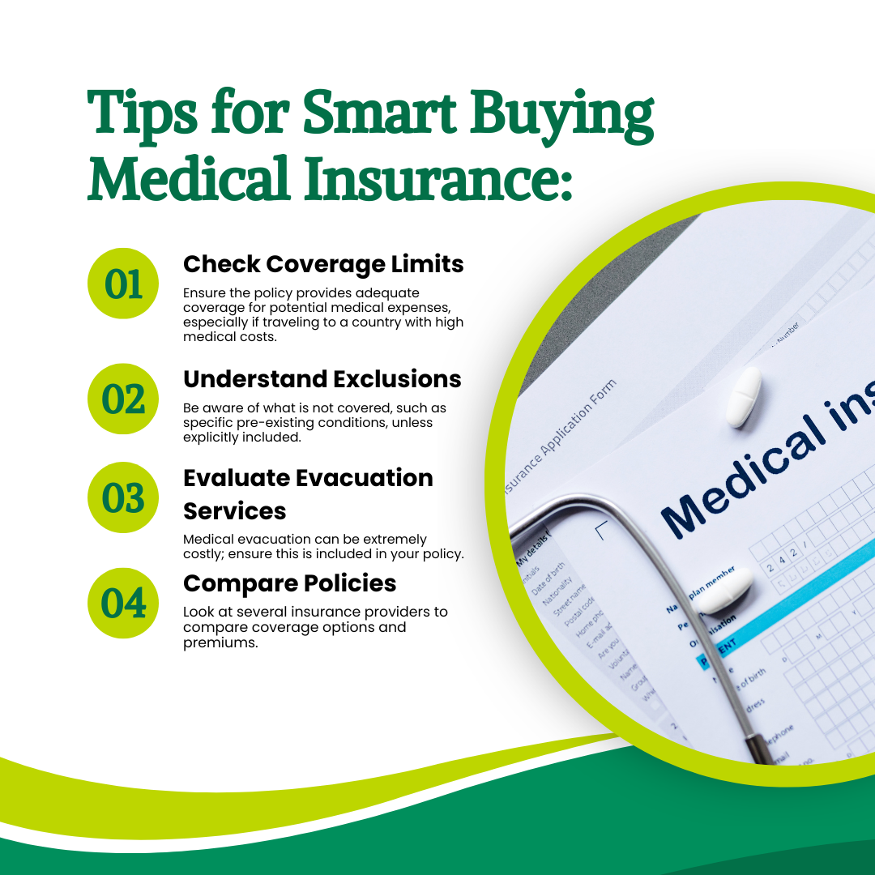


Slide 29




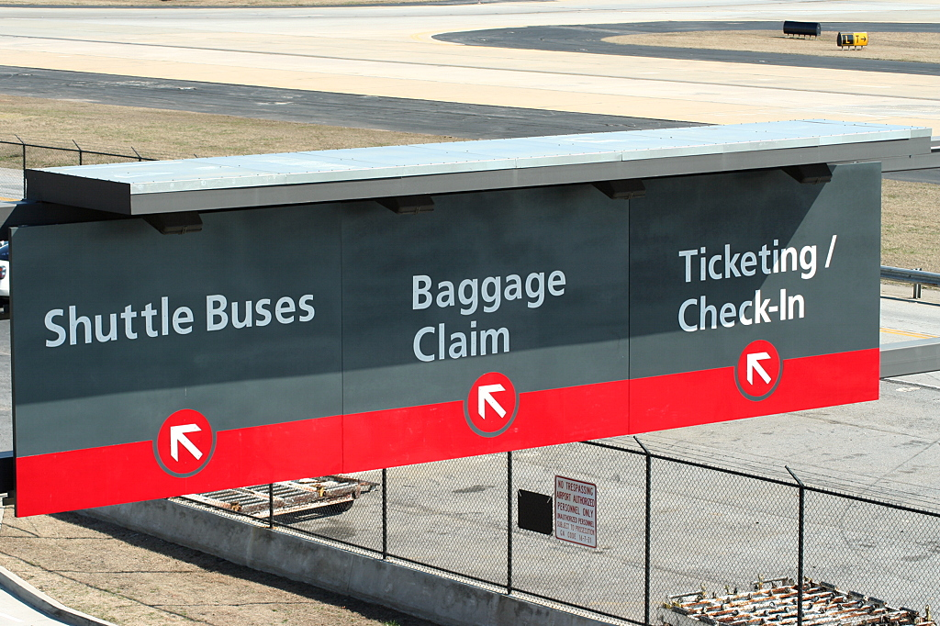


Unlock Your Potential
Inspire Change and Make a Global Impact
At The Ageless Ambassador Program, We:
Empower, inspire, and train individuals to become competent, enthusiastic volunteers poised to seize opportunities for global volunteering, fostering understanding among people from diverse backgrounds and cultures.
Our program is your gateway to unleashing your timeless skills, boundless energy, and innate compassion.
How To Become An Airport Volunteer
Listen to our podcast with Bary Kluger, who finds fulfillment in volunteering at Sky Harbor after an illustrious career at MTV.
Thank you, Barry, for introducing The Ageless Traveler to Airport Volunteer Programs.
Visit These Airport Websites:
Many airports have volunteer programs listed under their community or services sections. Look for terms like "volunteer" or "community involvement" on their websites.
Phoenix
Seattle
Pprtland
Atlanta
Jan Dougherty, a navigator volunteer and nurse specializing in dementia Care, reiterates the joy found in airports by reflecting on touching family reunions she witnessed while volunteering at Sky Harbor.
  "Once daunting mazes filled with travel-weary passengers, airports can become hubs of anticipation and adventure that speak volumes about the places and people they serve."
Listen to her podcast.

Slide 30
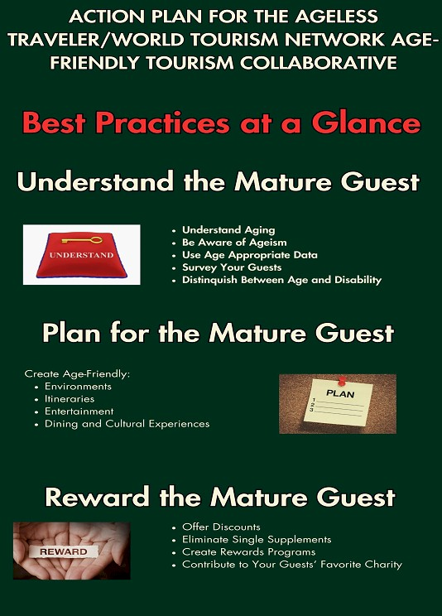

Are you a tourism industry professional?
Ageless Tourism Recognition (ATR) is a key to attracting, serving and retaining 60+ travelers. With the youngest boomers reaching 60 in 2024, the demand for mature travel experiences is set to soar. Capitalize on this generational shift by becoming an ATR-recognized business.

Slide 31
The National Family Caregiver Support Program (NFCSP) provides grants to states and territories to fund various support services that assist family and informal Caregivers.
AARP-Anyone facing a family Caregiving crisis can call AARP's hotline at 877-333-5885 and seek help in English or Spanish. AARP agents who run the helpline offer resources, including the 211 Caregiver Support Program, to get help delivered by over 220 local organizations across the country.
Aging Life Care Association (ALCA) a holistic, client-centered approach to caring for older adults or others facing ongoing health challenges.
Now that you have downloaded this eBook you will automatically receive ongoing additions to this Directory, via eMail.
For those interested in inclusion, whether you're from tourist boards, associations, NGOs, tourism-related companies, hotels, transportation, restaurants, itinerary and travel agents, age tech providers, equipment providers, pharmaceuticals, luggage, personal item providers, and more, visit us at The Ageless Traveler and contact us.
Expand your reach!
Directory
Care Giver Resources:
Organizations in the USA and Canada
The National Caregiver Support Program offers a range of services and resources for family Caregivers.
Care for The Caregiver from Emblem Heath recognizes the health needs of the "silent patients" and is designed to serve as a resource.
Alzheimer's Association gives leads to their team of people providing daily caregiving.
Family Caregiver Alliance provides quality information, support, and resources related to family caregiving.
Verywell Health providing health and wellness information by health professionals, including traveling with Alzheimer's Disease
Caregiver Action Network (CAN) offers educational resources, peer support, and Respite Care resources for Family Caregivers.
SATH (Society for Accessible Travel and Hospitality bringing together national and international organizations of and for persons with disabilities and those organizations providing services to travelers
Organizations in Australia
Carers Australia provides advocacy, support, and resources for Carers, including information on Respite Care and travel assistance.
Australian Government Department of Social Services offers support and services for Carers, including financial assistance and Respite Care options.
Organizations in England
Carers U.K. provides advice, information, and support to Carers, including resources on planning travel and accessing Respite Care.

Slide 32
Specialized Dementia Travel Resources
Organizations in India
Alzheimer's and Related Disorders Society of India (ARDSI) provides support and resources for dementia Care.
Caregiver Saathi offers resources and guidance for Caregivers, including travel tips and travel assistance for those with Dementia.
Organizations in Canada
Alzheimer Society of Canada offers travel tips and advice for Caregivers traveling with loved ones who have Dementia.
The Dementia Society of Ottawa provides comprehensive travel tips for dementia Caregivers.
Caregiver Exchange shares resources and stories from other Caregivers, including travel experiences.
Organizations in the USA
Caregiver Action Network (CAN) offers resources and a community for Caregivers, including travel advice and support groups.
Dementia Care Central provides Caregiving tips, including sections on travel and outings with dementia patients.
Organizations in the United Kingdom
The Alzheimer's Society (U.K.) - Holidays and Travel
Traveling with Dementia from Dementia U.K. offers guidance for Caregivers planning to travel with someone who has Dementia. Their articles are full of valuable tips and strategies to help you plan a trip, whether to family gatherings or abroad.
Organizations in Australia
Dementia Australia provides resources and support for traveling with Dementia
Alzheimer's Queensland offers advice and resources for dementia Caregivers, including travel tips.
At the Aging Life Care Association, you will find somebody to be your right-hand person when you are traveling, and that will give you peace of mind and allow you to enjoy your vacation.
Visit the Aging Life Care Association website, put in your zip code, and find the members of ALCA within a twenty-mile, fifty-mile, and one-hundred-mile radius, and a description of their expertise.

Slide 33





From Our Panel of Experts
For those interested in inclusion, whether you're from tourist boards, associations, NGOs, tourism-related companies, hotels, transportation, restaurants, itinerary and travel agents, age tech providers, equipment providers, pharmaceuticals, luggage, personal item providers, and more, visit us at The Ageless Traveler and contact us.
Expand your reach!
How to Travel in Luxury for Less
Download Your
Free Copy, Here

